Slide 1

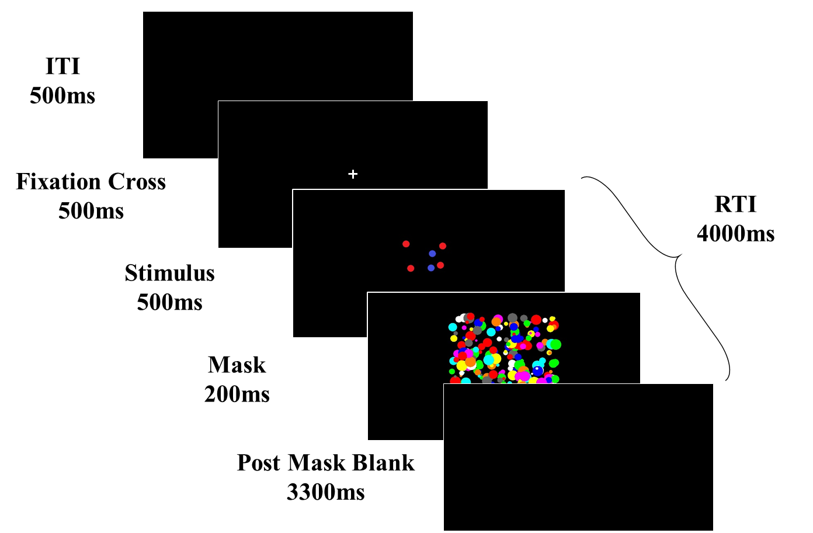
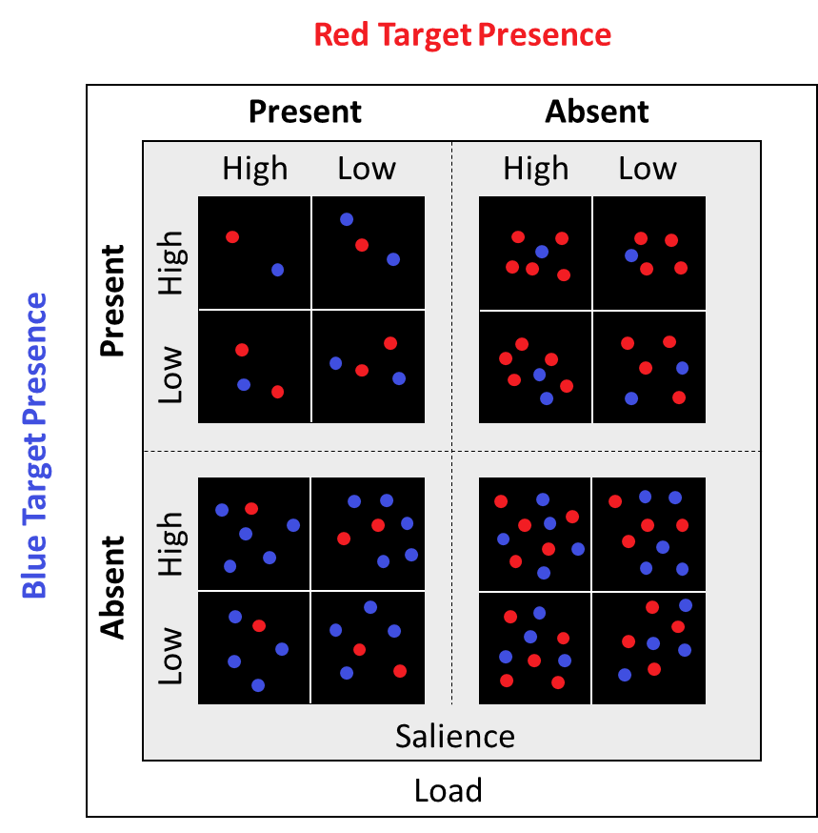
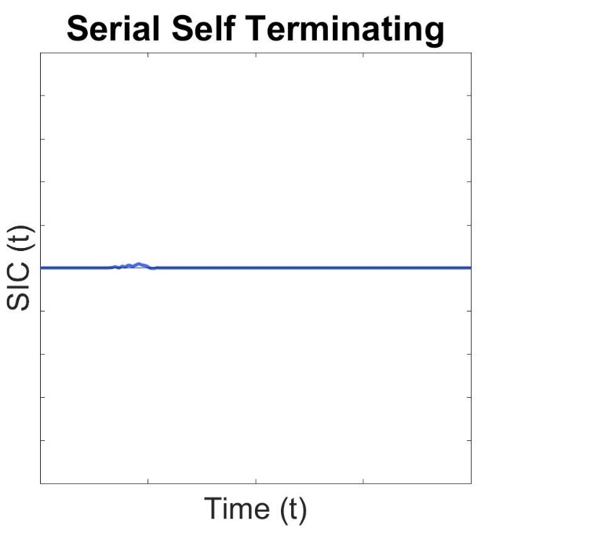
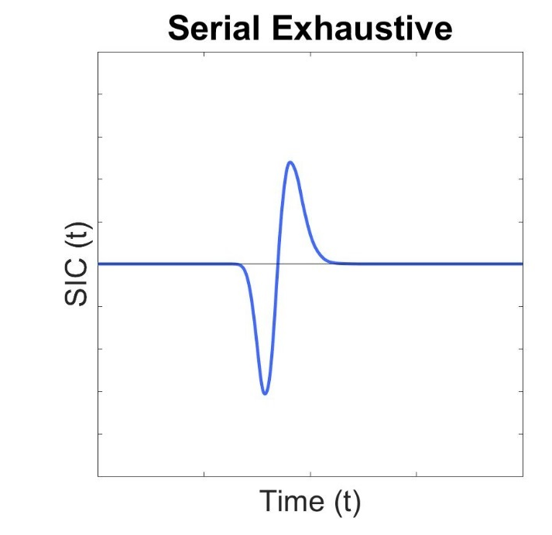
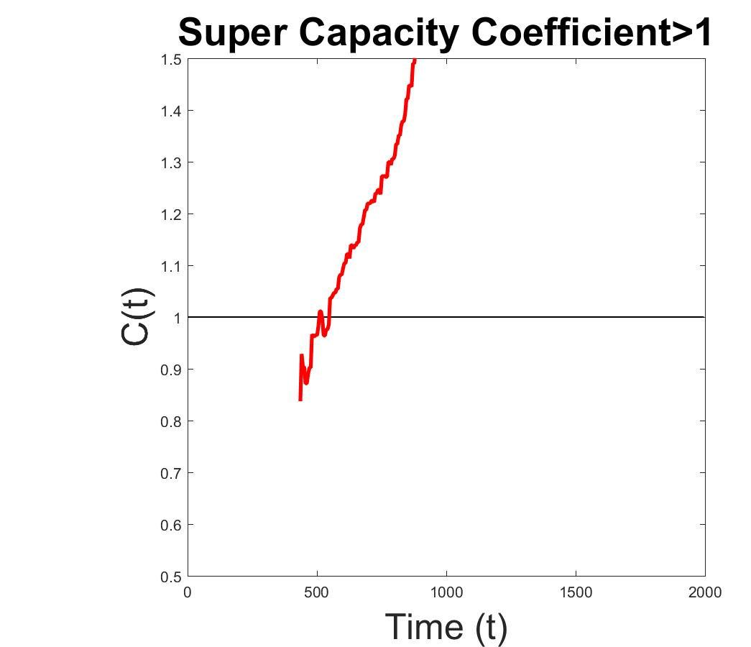
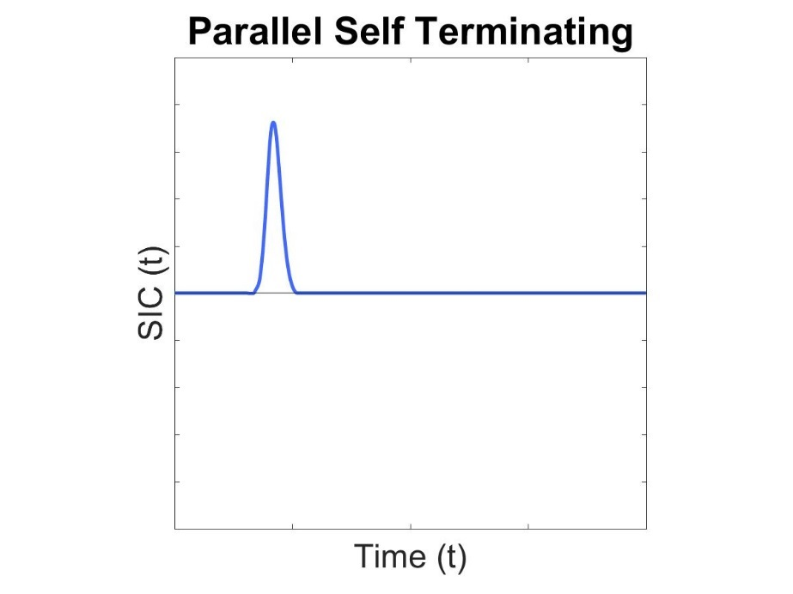
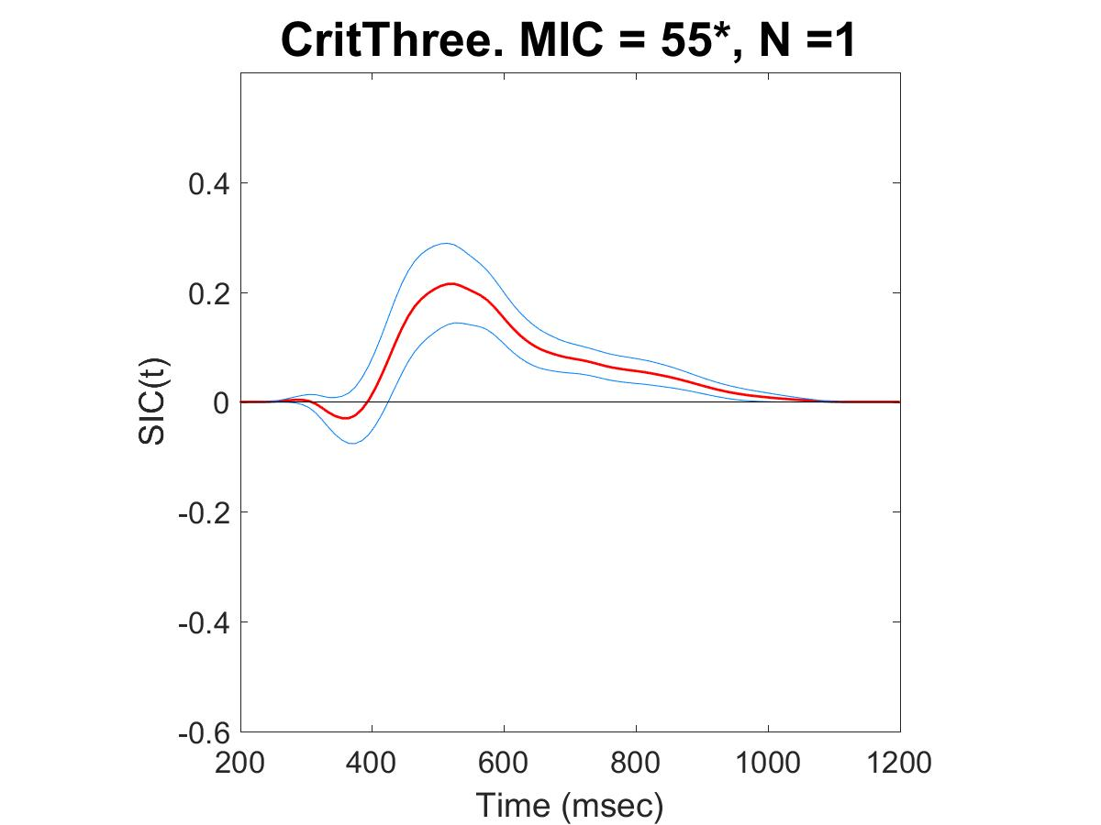
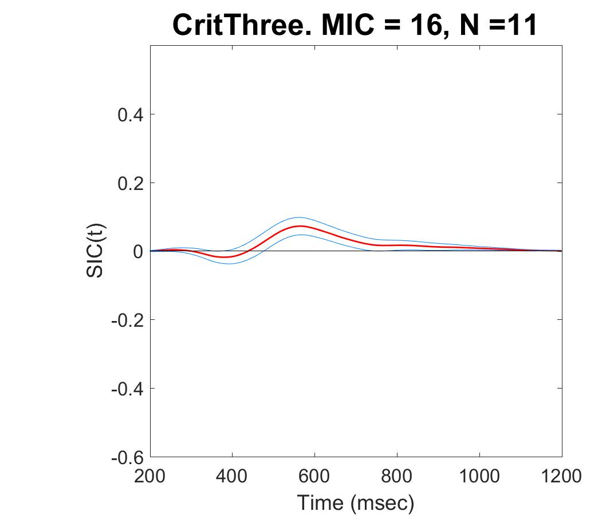
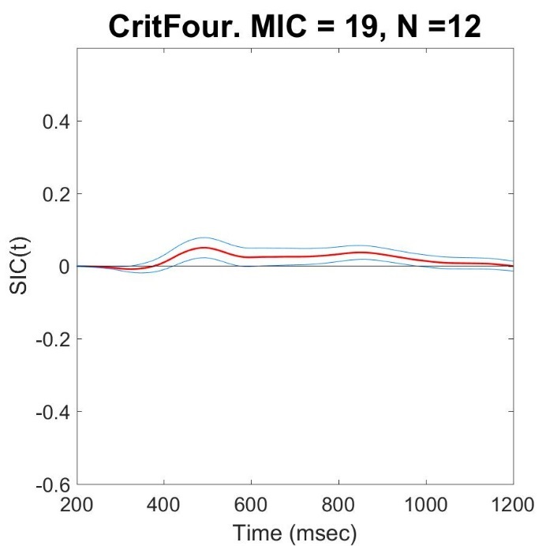
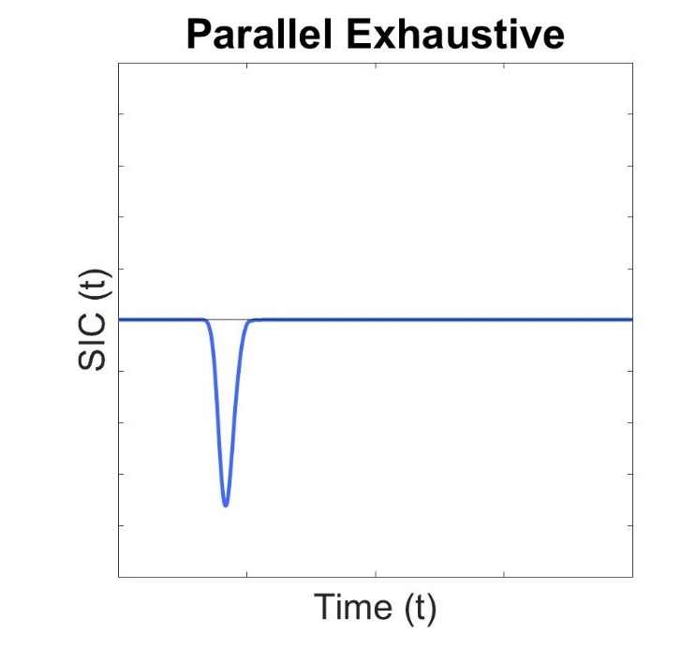
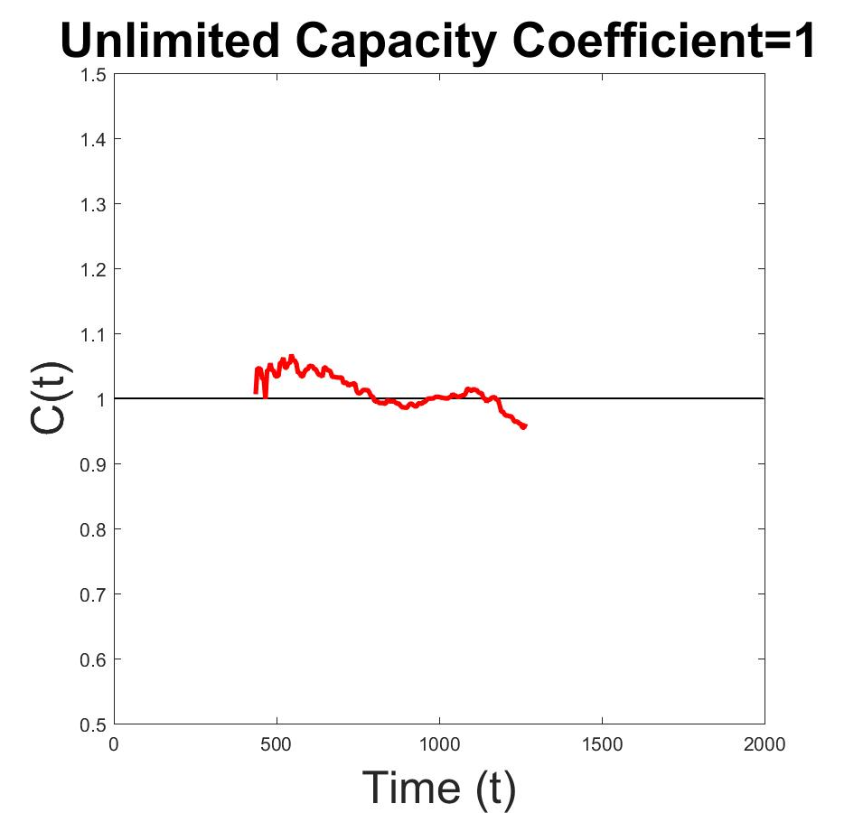
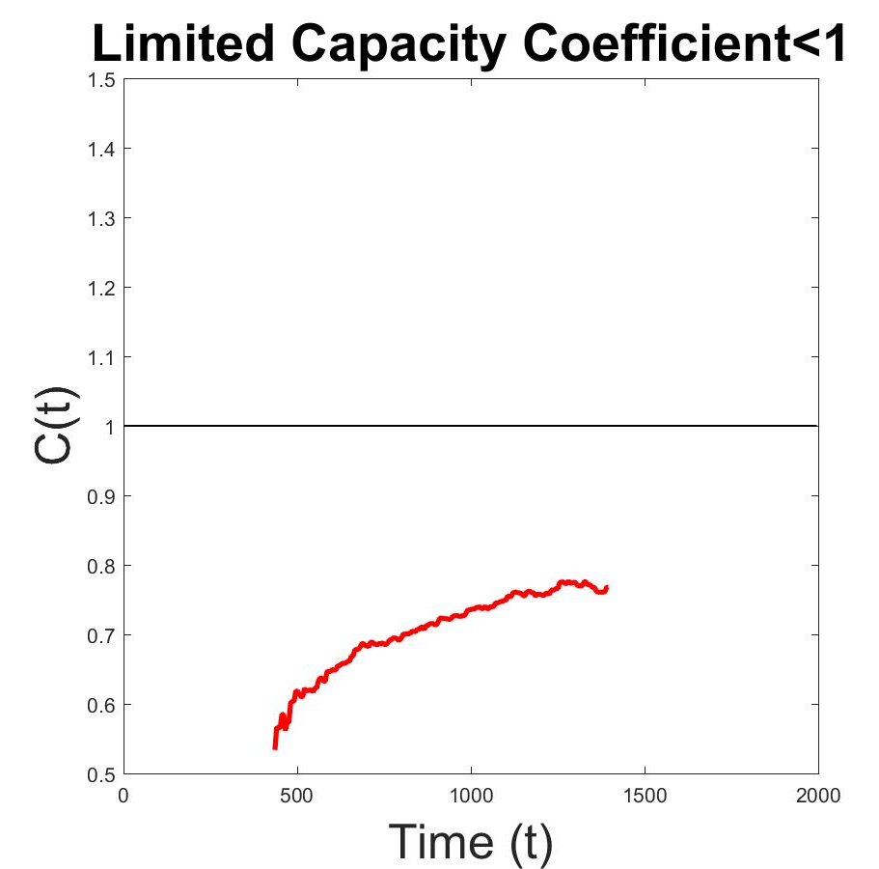
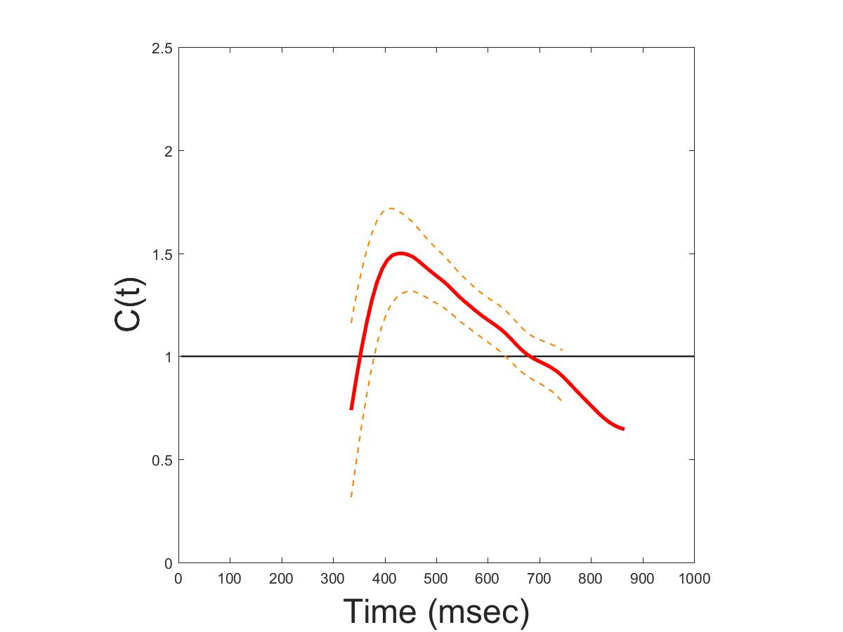
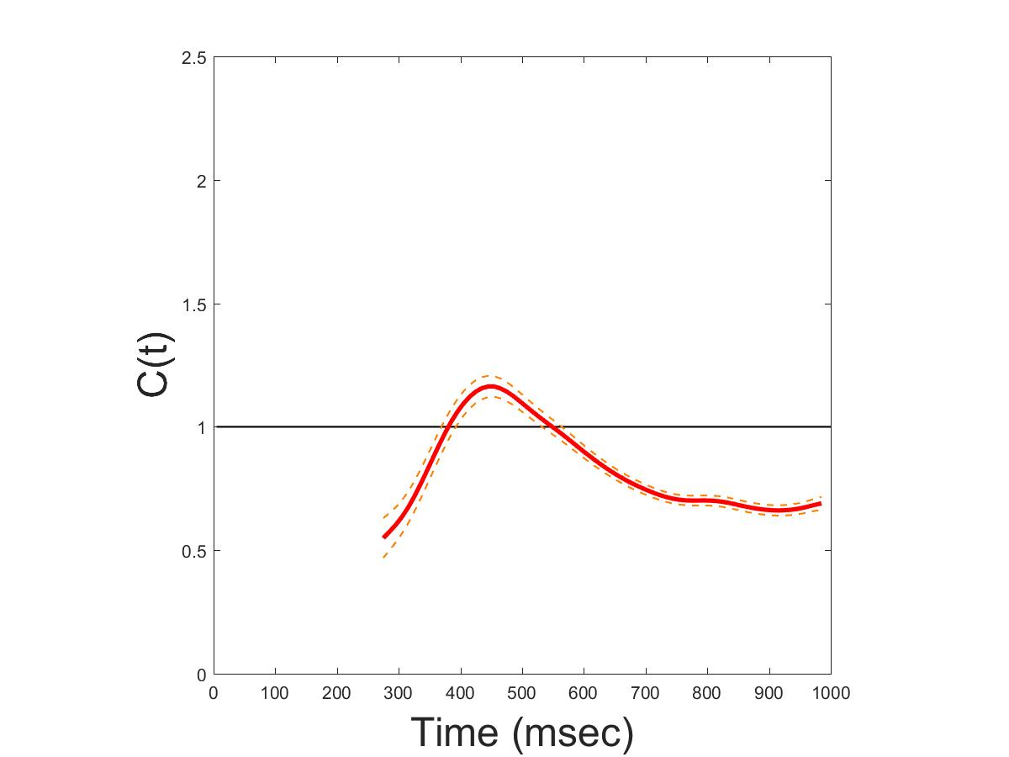
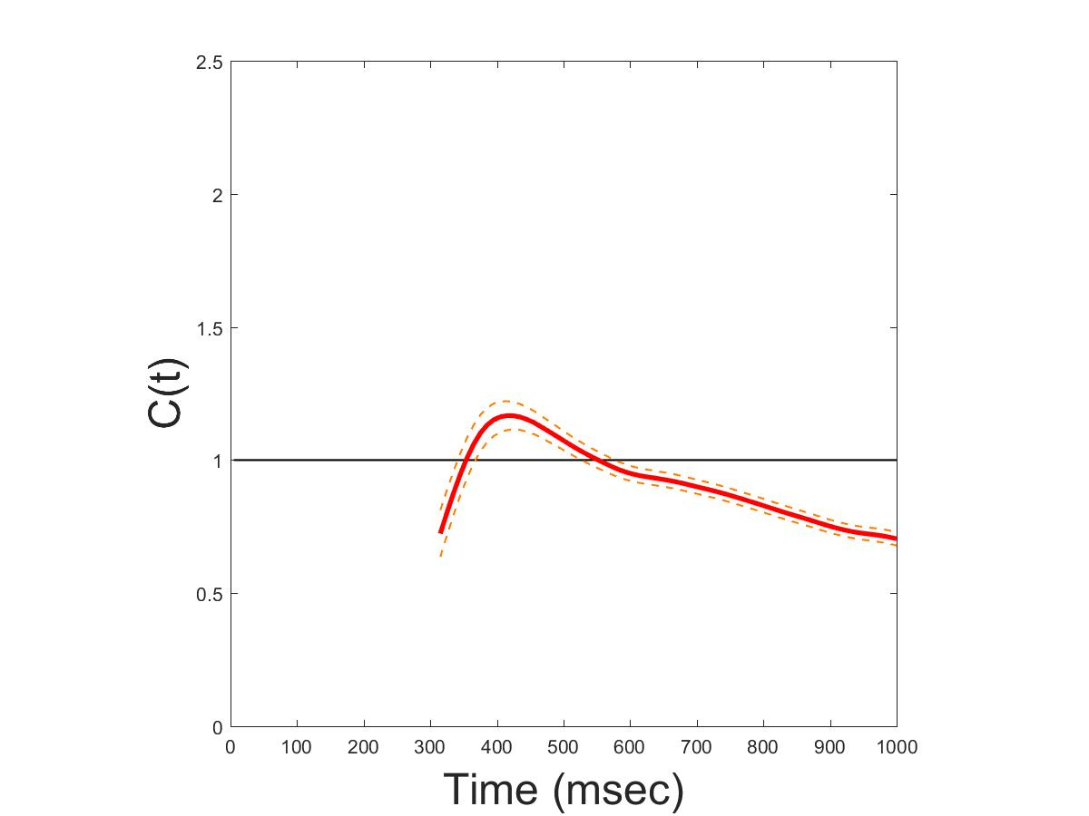
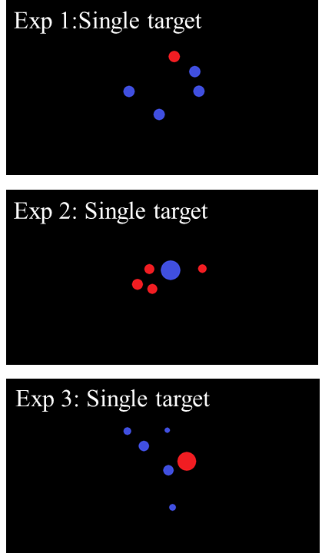
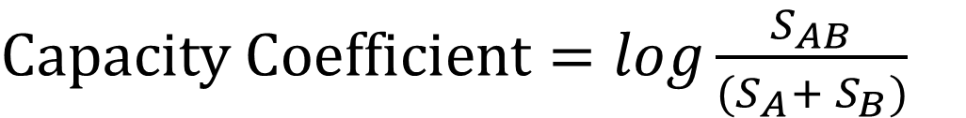
How Do You Count?
Cognitive Processing Systems of Enumeration
Paul Garrett^{1,} Alexander Thorpe¹, David Landy², Joseph Houpt³ & Ami Eidels¹
Paul.Garrett@newcastle.edu.au
¹ The University of Newcastle, Australia, ² Indiana University, Bloomington, USA, ³ Wright State University, Ohio, USA
Background
Enumeration – the ability to quantify item sets, basic to our everyday life.
For example, choosing the least busy queue at airport security. How is it that we make these decisions with such speed and accuracy?
Subitizing¹, for the rapid and effortless enumeration of item sets 1-4
Counting² for the slow and accumulative enumeration of item sets 5-12. If subitizing is effortless, then subitizing two independent item sets (i.e., queues) may occur simultaneously or in a Parallel System. We applied an advanced Mathematical Framework method and Analysis Technique, called Systems Factorial Technology (SFT)³.
SFT affords unique System Signatures to diagnose Parallel and Serial (Sequential) Systems (Figure 1a), while independently assessing System Workload or ‘Effort’ (Figure 1b). If Parallel System Subitizing were Effortless, System Capacity would be classified Unlimited.
2a)
Blocks = 13
Trials = 96
2b)
Time (ms)
$$Mean Interaction Contrast (MIC)= {RT}_{HH} − {RT}_{HL} − {RT}_{LH}+ {RT}_{LL}$$
Target Criterion < 3
$$Survivor Interaction Contrast (SIC)= S_{HH} − S_{HL} − S_{LH}+ S_{LL}$$
$Capacity Coefficient=log\frac{S_{AB}}{(S_{A}+ S_{B})}$
Where RT = meanRT, H = High Salience, L = Low Salience, S = Hazard Function,
AB = Double Target, A = Single Target Red and B = Single Target Blue
Results
1a)
1b)
Experiment 1: Evenly Sized Dots (Analysis Example)
Hypotheses
Outcome
Figure 1.a. Survivor Interaction Contrasts (SIC) used to diagnose Parallel and Serial Systems
1.b. Capacity Coefficient. Diagnose Workload: Unlimited equates to Effortless processing
Experiment | Criterion Three | Capacity | Criterion Four | Capacity
Even Size Dots | Serial N = 11 Parallel N = 1 | Unlimited | Serial N = 12 | Unlimited
Predictive Surface Area | Serial N = 8 | Unlimited | Serial N = 11 | Unlimited
Forced Subitizing | Serial N = 12 Parallel N = 2 | Unlimited | Serial N = 12 Parallel N = 2 | Unlimited
Methods
Undergraduate students (N=71) were tested at the University of Newcastle Cognition Laboratory. Participants viewed two intermixed item sets, a Red set and Blue set. Using a keyboard, participants responded ‘z’ if at least one colour set was less than three, or ‘/’ if neither colour set was less than three (see Figure 2a). An alternate criterion of four was also used.
Experiment 1:
Even size dots in both Color-Sets
See Figure 2b for Stimulus combinations.
Experiment 2:
Color-Set Surface-Area constant both Within and Across trials.
Made Surface Area predictive of number.
Experiment 3:
Color-Set Surface-Area constant Within but not Across trials.
Forced the use of subitizing or counting for accurate trial discrimination
Conclusion
Two item-sets may be subitized in Parallel under conditions of Unlimited or Effortless Workload, however Sequential or Serial subitizing was preferred (66 / 71 Ps).
Serial and Parallel System Subitizing showed effortless (Unlimited) processing. Serial and Parallel groups showed no mean RT difference. This indicates no advantage in either strategy. These results suggest that the observed preference for Serial Subitizing may be a learned phenomenon, which may stem from our everyday use of Sequential Counting.
Future Research
Investigate whether Parallel System Subitizing is a learned enumeration strategy
If Parallel System Subitizing is present in children and when Serial System Subitizing becomes the preferred strategy
If learning Parallel System Subitizing as a child may help to expand our Mental Number Line past the boundary of four.
References
¹ Kaufman, E. L., Lord, M. W., Reese, T. W., & Volkmannm J. (1949). The discrimination of visual number. The American Journal of Psychology. 2 (4), 498-525
² Gelman, R. & Gallistel, C. R., (1978). The child’s understanding of number. Cambridge, MA. Harvard University Press Gullaume, Bys, Mussollin & Content, 2013
³ Townsend, J., & Nozawa, G. (1995). Spatio-temporal properties of elementary perception: an investigation of Parallel, Serial and Coactive theories. Journal of Mathematical Psychology. 39 (2), 321-359

